Slide 1
Delicious Design
Kelly Juntenen

Slide 2
Objective:
Take a hands-on approach to learning basic yearbook design.

Slide 3
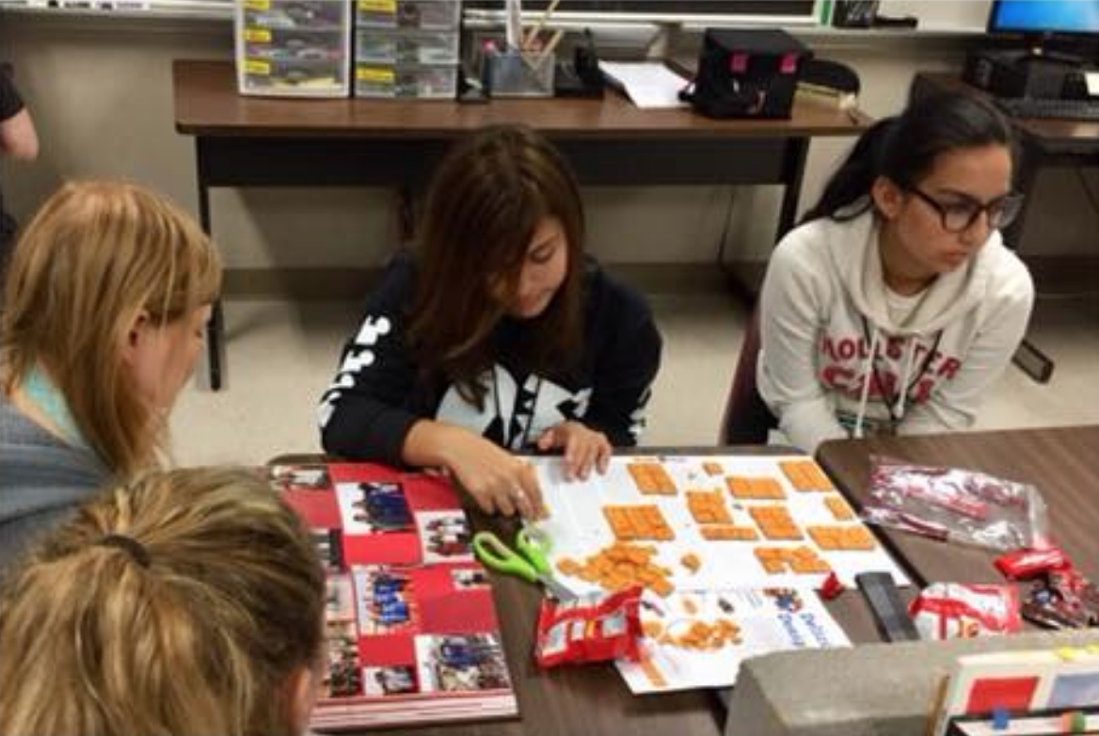

Slide 4
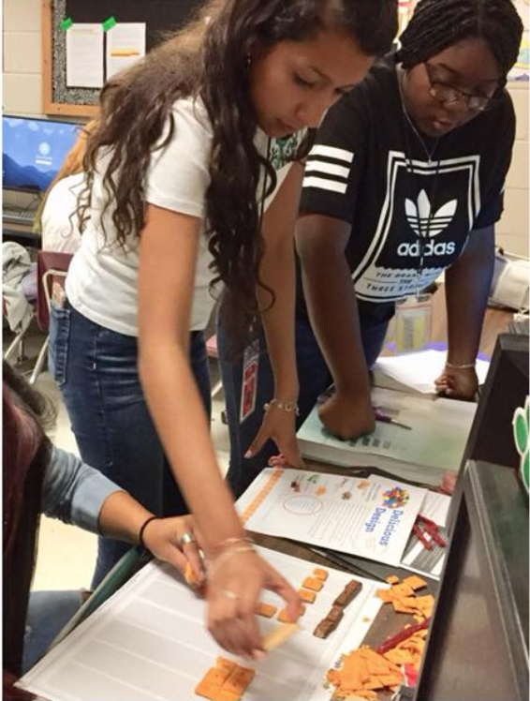
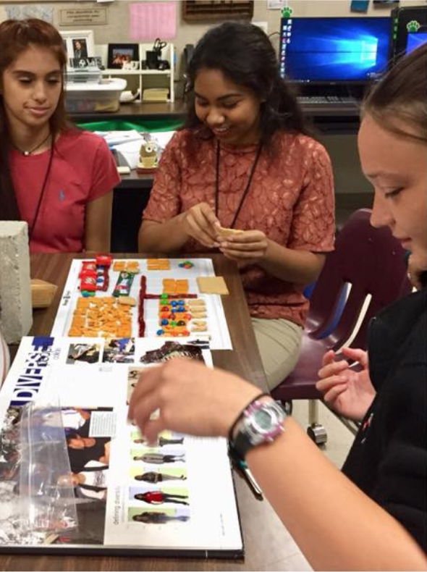

Slide 5
What elements are part of a yearbook page?
Pictures
Words
White Space

Slide 6
Let’s divide pictures into 2 groups:
Dominant photo
All other photos

Slide 7
Dominant Photo
Every spread needs a dominant photo that is 2-3 times bigger than the next biggest picture
A dominant photo tells a reader “HEY LOOK AT ME FIRST!”

Slide 8
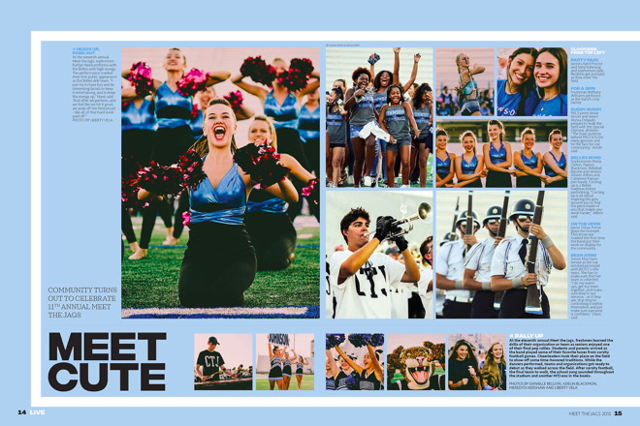

Slide 9
Words can be divided into 3 groups
Headline
Body Copy (main story)
Captions

Slide 10
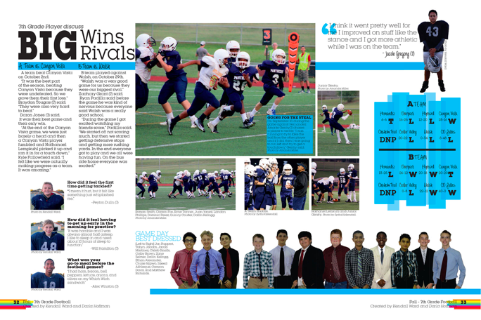

Slide 11
White space is strategically placed on a layout
All elements have 1 pica of white space between them
More spacious spots should be near the exterior of the layout

Slide 12
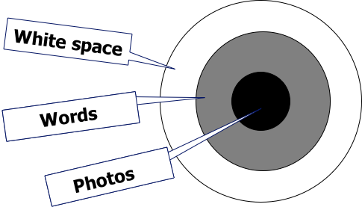

Slide 13
Design Key
Dominant photo
Secondary photos
Headline/Copy
Captions
(Eyeline)
White space
Graham crackers
C&B crackers
Goldfish
M&Ms
Twizzlers
Nada

Slide 14
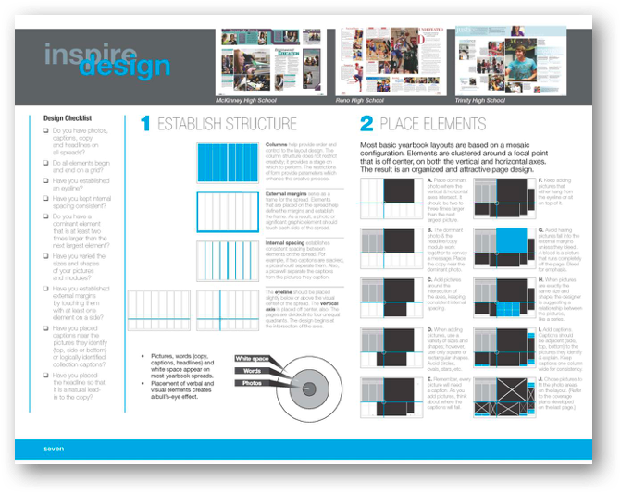
This corresponds w/Yearbook Playbook pg. 7

Slide 15

What’s a column?

Slide 16
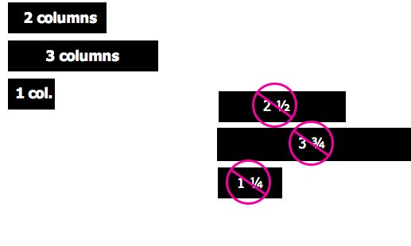
All elements must start
and stop on a column

Slide 17
Take a moment to view gutter, internal spacing and pica squares

Slide 18
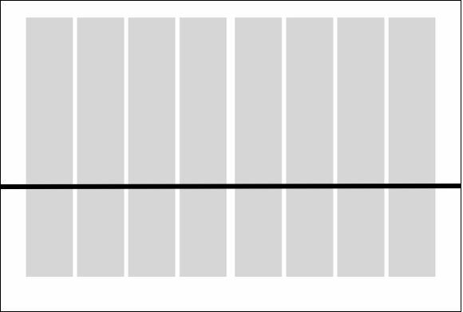
Place an eyeline on your spread

Slide 19
An eyeline is a horizontal line that goes all the way across your pages. It guides a viewer to know which way to look.
Also, it’s not a real line.

Slide 20
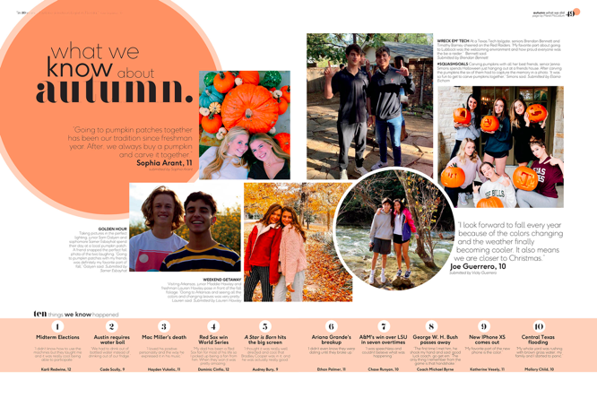

Slide 21
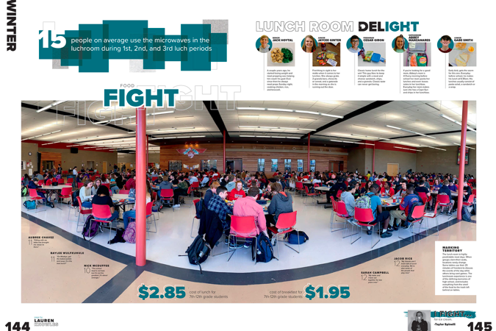

Slide 22
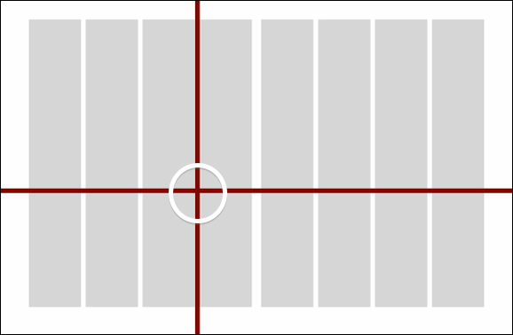
Place a vertical axis on your page
Use Twizzlers

Slide 23
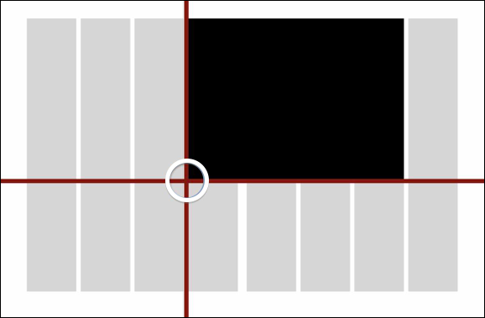
Place your dominant photo in the largest quadrant. Build from the axis point OUT.
Use graham crackers

Slide 24
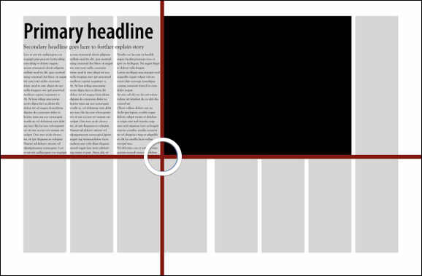
Place your story and headline across from your dominant photo (visual/verbal connection)
Use goldfish

Slide 25
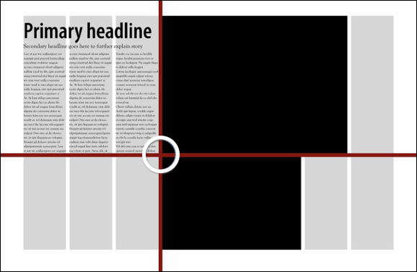
Place your next largest photo off of the axis point. Consider your caption placement.
Additional crackers

Slide 26
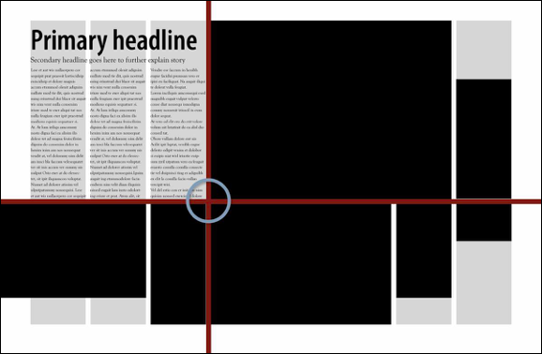
Use varying shapes and sizes to fill the rest of your spread. Resist the urge to go all the way to every corner.
Additional crackers

Slide 27
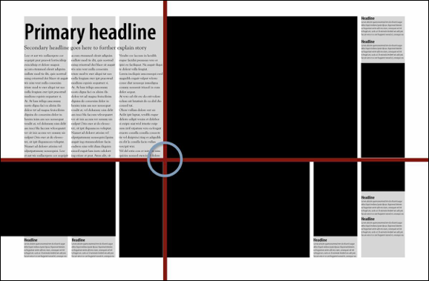
Tuck in your captions.
M&Ms

Slide 28
Remove Twizzlers!

Slide 29
Do a Design Check
Do Design Check

Slide 30
Is there 1 pica between every element?
Do you have an eyeline that spans the page?
Have you achieved the bulls-eye effect?
Does every photo have a caption?
Have you avoided trapped copy?

Slide 31
Extra Credit
Try building a layout that incorporates a “rail” of space
(3 picas!)

Slide 32
