Slide 1
Typography
all about

Slide 2
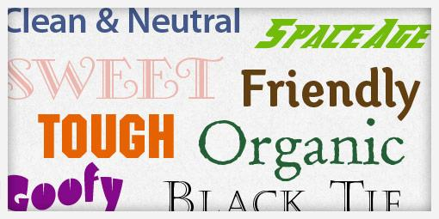
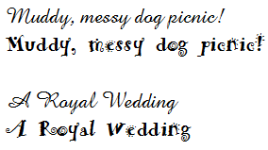
What is typography?
Simply put, the arrangement of type. Type can make a difference in how things are perceived.
All typefaces are divided into different categories, also called races, and each race has a set of distinct characteristics.

Slide 3




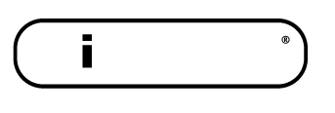
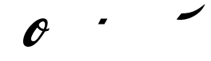




Guess that logo!

Slide 4
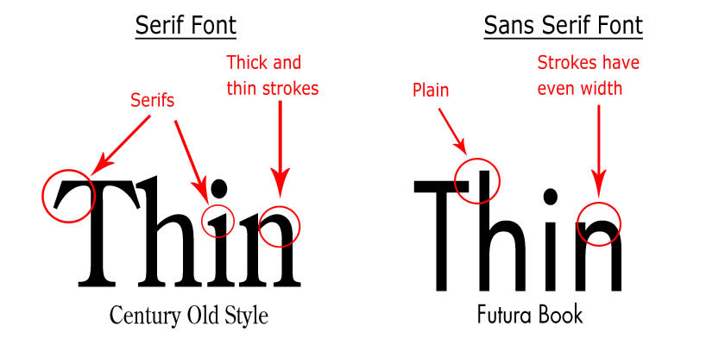
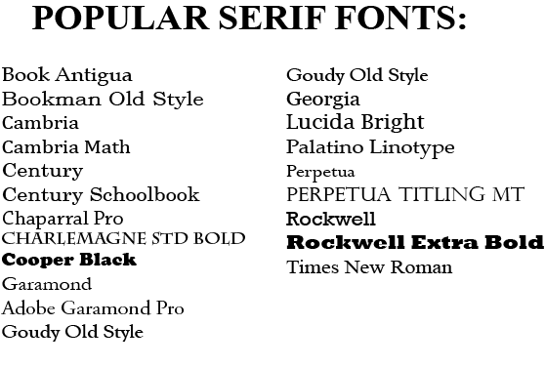
Serif
Have tails called “serifs” at the end of each letter
Thick and thin strokes
Usually used as body copy because they are easier to read at smaller sizes

Slide 5
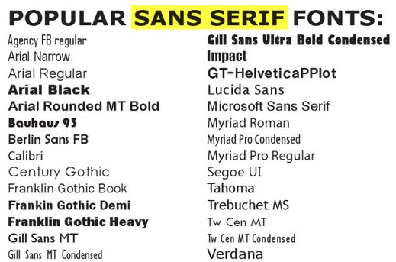
Sans Serif
Sans in Latin means “without.” So sans serif means without serif.
Lack finishing strokes
Best paired with serif typefaces. Provides contrast.

Slide 6
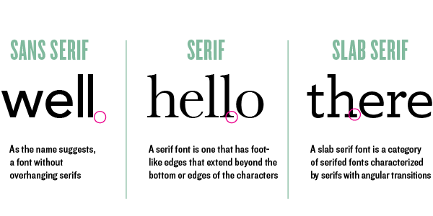
Slab Serif
Also known as square serif
They are the trendier more popular serif
Include large, block-like tails

Slide 7
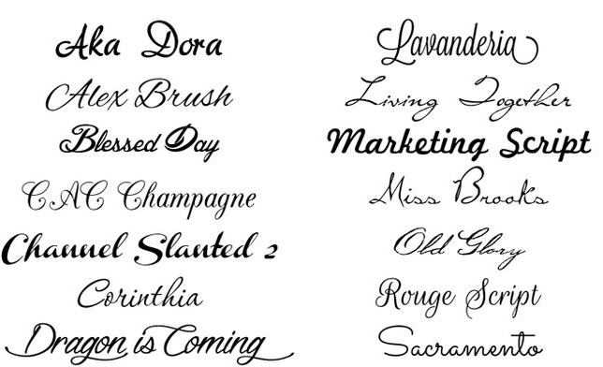
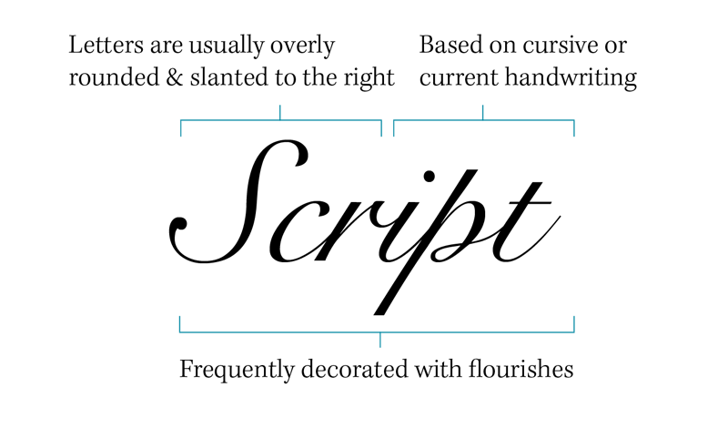
Script
Imitate handwriting with letters that flow into each other
Cannot use for body copy
Best for headlines and highlighting words

Slide 8
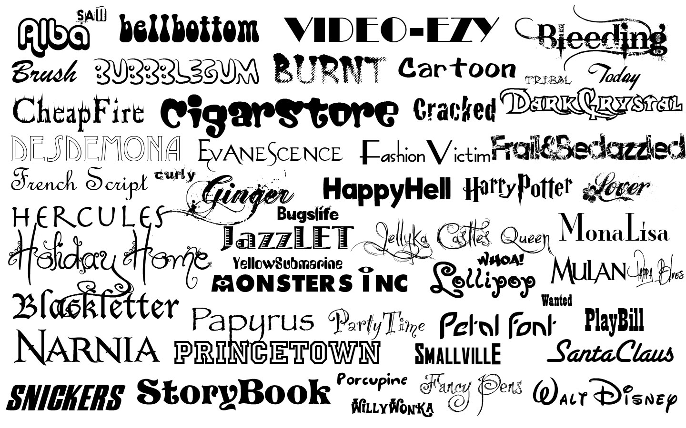
Novelty
Decorative typefaces that don’t fit in any other category
Used sparingly because they are difficult to read and are too trendy

Slide 9
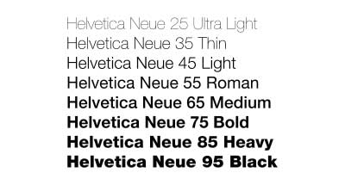
Font Families
A set of one or more fonts that share common design features but are different styles and weights
Example: Family name Helvetica Neue

Slide 10
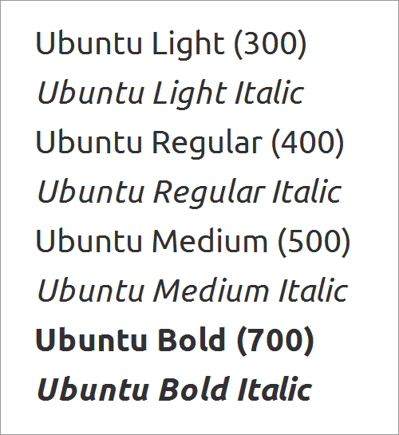

Font Styles
Different types of formatting available for the type.
Medium/Roman/Regular: standard choices for fonts with no formatting
Oblique/italic: Slants slightly to the right
Bold: type with a strong/vivid appearance to show emphasis
Condensed: Font where characters are tightly spaced, more narrow than standard
Light/Thin: Thinner or has less definition

Slide 11
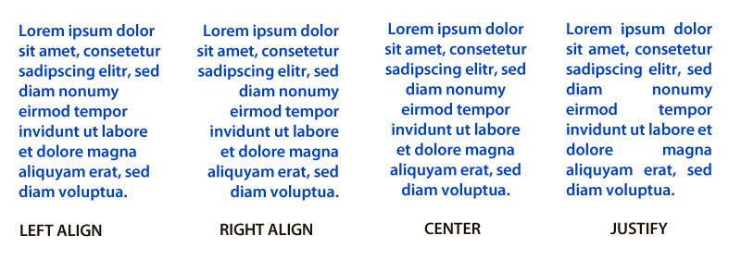
Text Alignment
Used less because they are hard to read
AKA Flush Left/Ragged Right
AKA Flush Right/Ragged Left

Slide 12
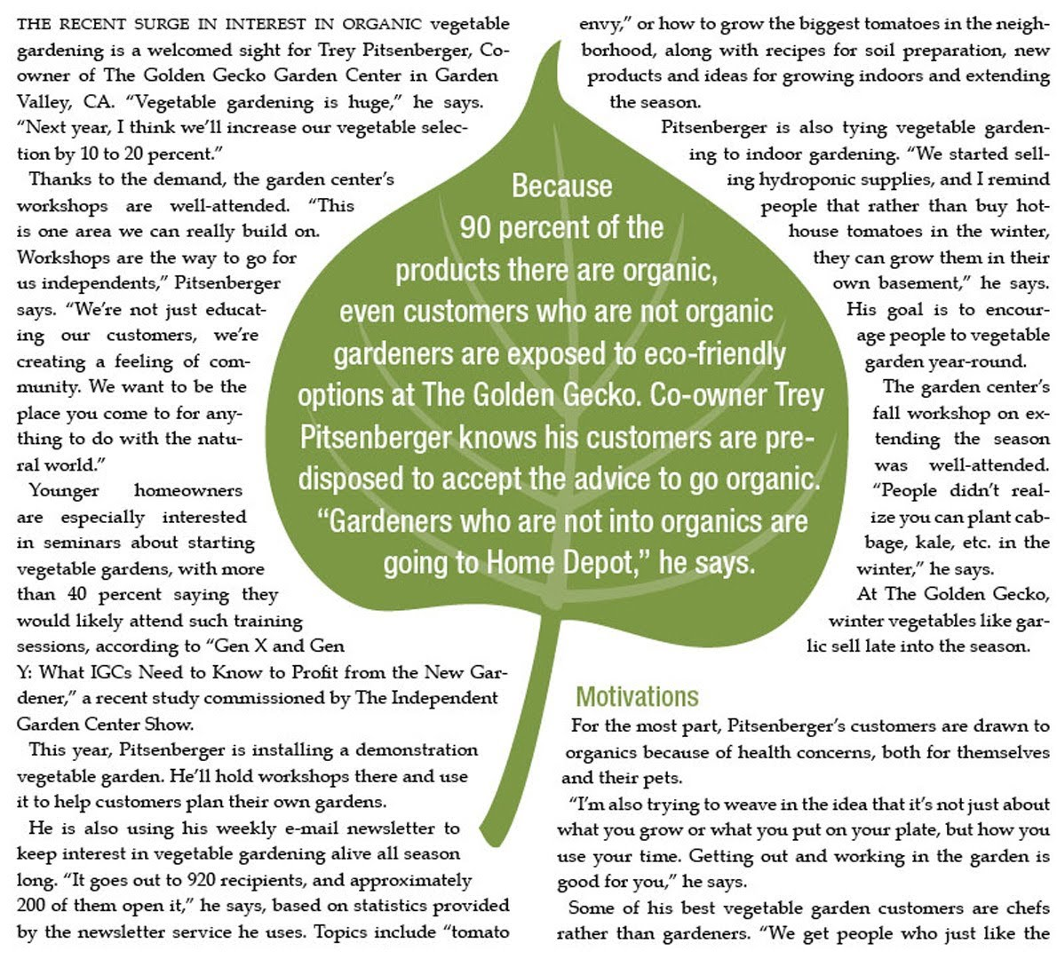
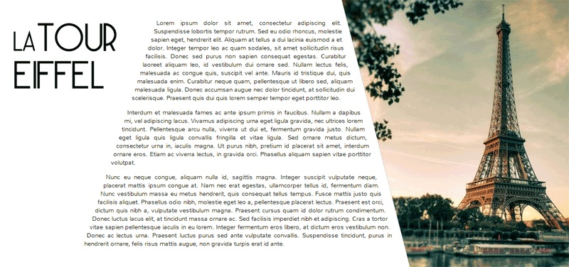
Text Wrapping

Slide 13
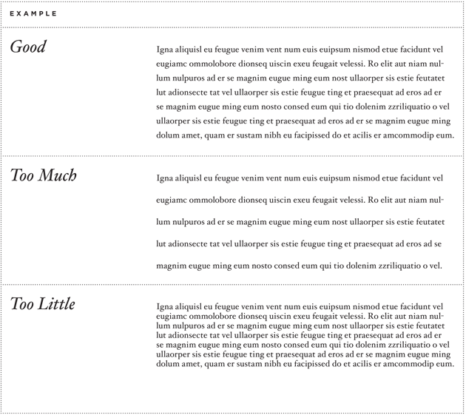
Type formatting (typesetting)
Leading: Space between lines of type. Generally leading should be 2 points larger than type size. EX 10/12 (type size listed first/leading listed second)

Slide 14
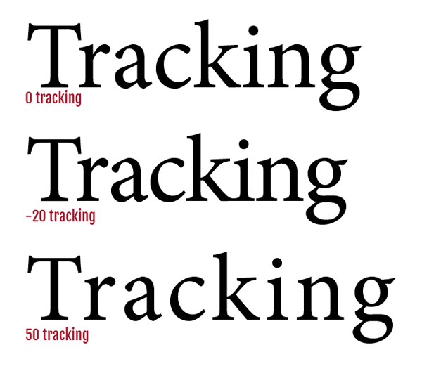
Type formatting (typesetting)
Tracking: Overall space between all letters and words in a body of text.
Can be increased +/- 10. Can go +/- 10 without affecting readability. Don’t go beyond that.

Slide 15

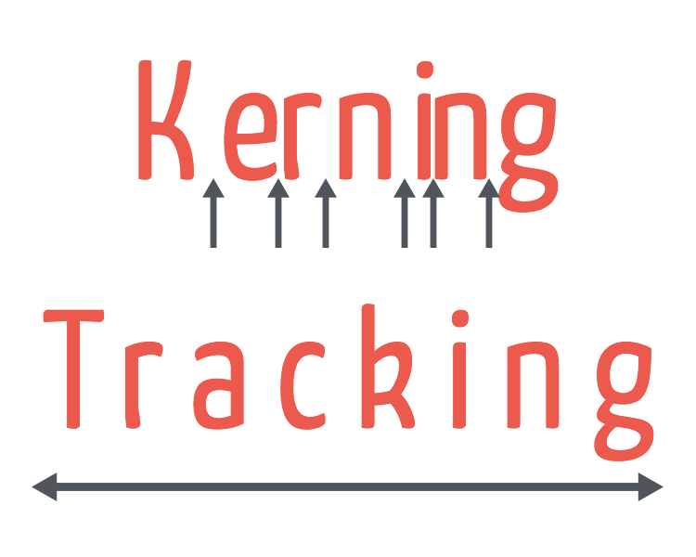
Type formatting (typesetting)
Kerning: Space between two individual letters. The amount of space between two characters can be increased or decreased.

Slide 16
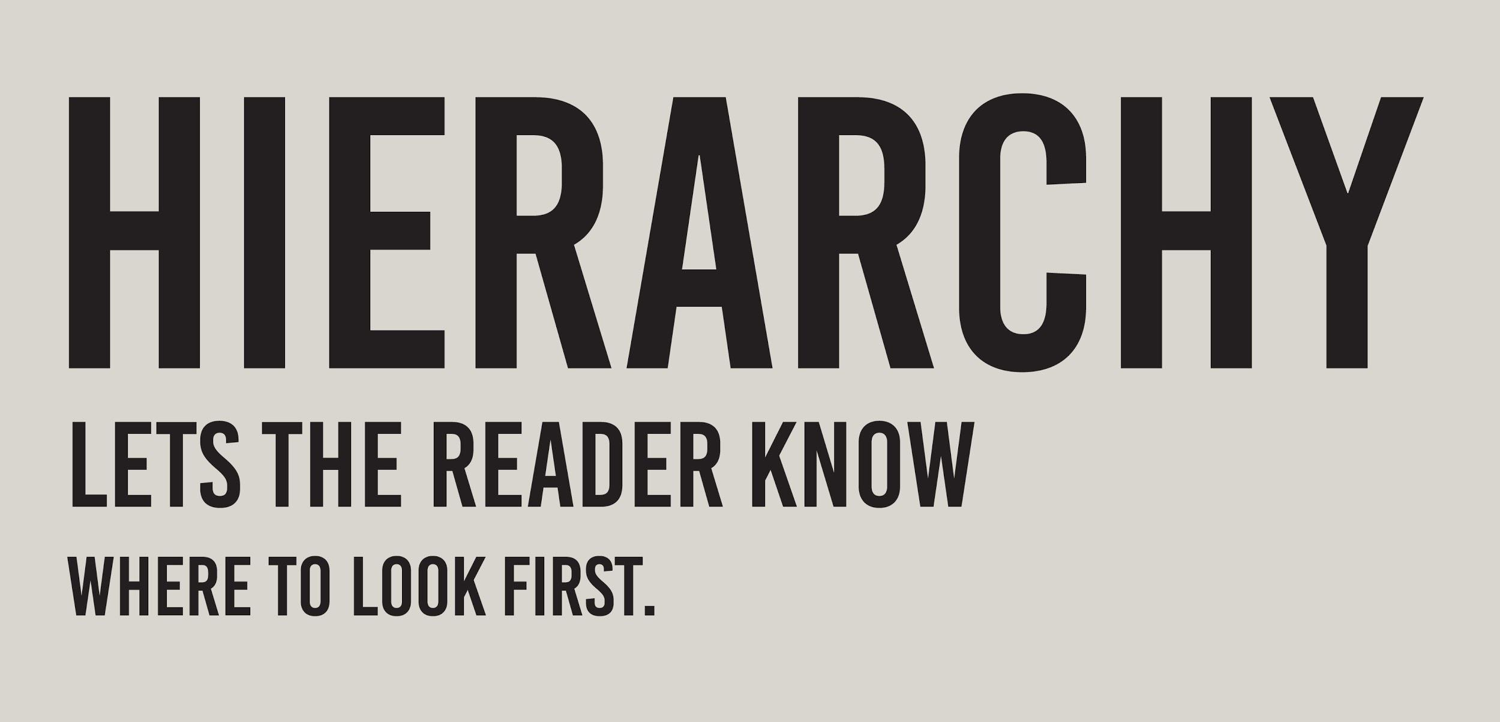
Type Hierarchy
If all type was the same size, it’d be a challenge to find what was most important
Headlines should be biggest, subheadlines a little smaller, body copy smaller yet, captions even smaller

Slide 17
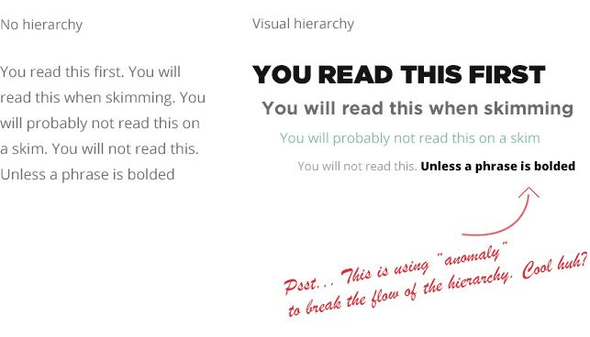
Type Hierarchy

Slide 18
Mixing Type
Mixing type races or styles can add contrast and visual interest
  Examples:
    All-caps paired with regular type
    Serif paired with sans serif
    Sans Serif paired with script
DON’T MIX MORE THAN TWO TYPEFACES IN ONE DISPLAY
  BUT, you can use as many of the styles in each font family as you want
  Readability should be the focus of every design decision

Slide 19

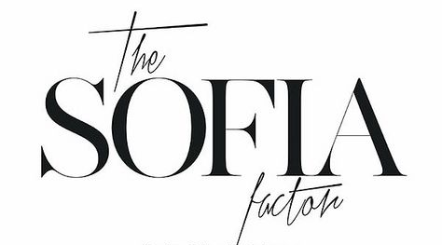
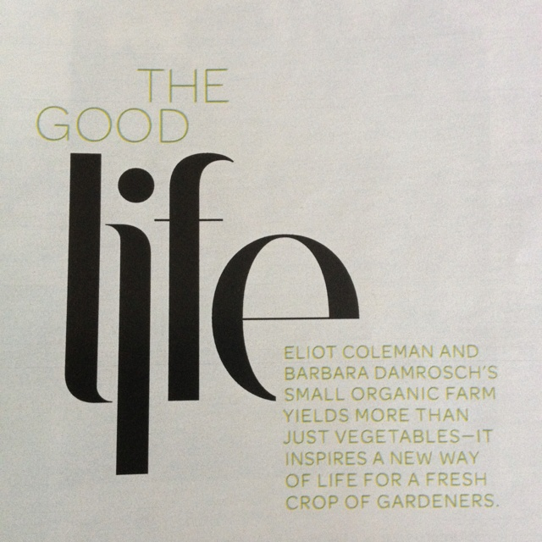
Mixing Type Examples

Slide 20
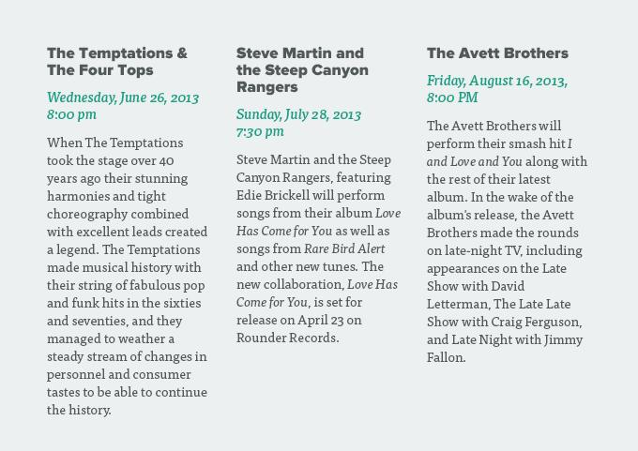
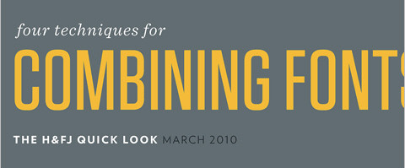
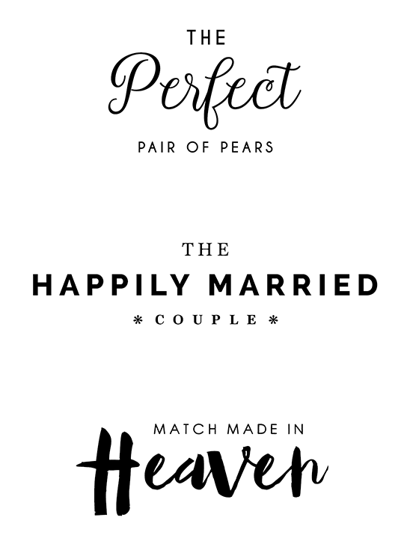
Mixing Type Examples

Slide 21
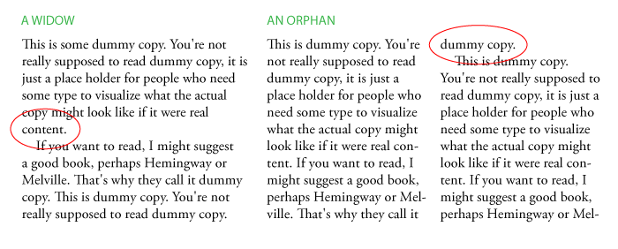
Type Crimes! - Widows & Orphans

Slide 22
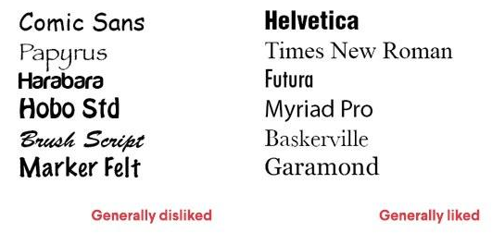
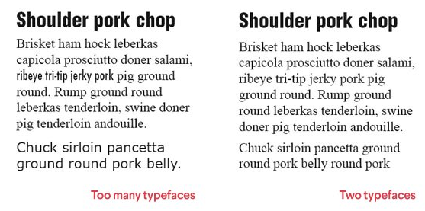
Type Crimes! - Choosing the wrong typefaces

Slide 23
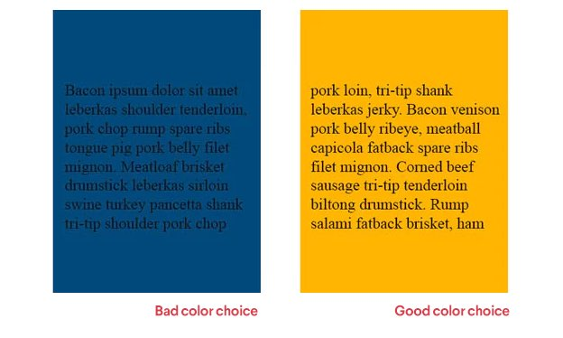
Type Crimes! - Poor Color Choices
Need to have good contrast between background color and text color

